Slide 1
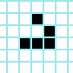
John Conway’s Game of Life
Presented by:
Maya Talpai-Vasinthascha and Sadaf Sadre Arhami
Notes:
OLD slides found here for easy access/reference in case: https://docs.google.com/presentation/d/1csw2JnpsbzRYqmxxvn-X6ukfbgIlM_vn3Q900uATt-s/edit#slide=id.g2d038bece52_0_0

Slide 2
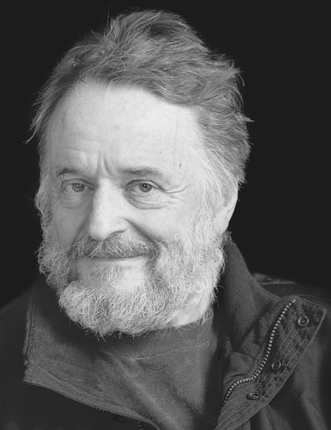
Who is Conway?
British Mathematician
active in combinatorial game theory, number theory, and coding theory
Slingshot the cellular automaton field of mathematics into popularity
Conway’s game is applied to many fields in biology, chemistry, physics, and computer science to model systems that can “evolve”
1937-2020

Slide 3
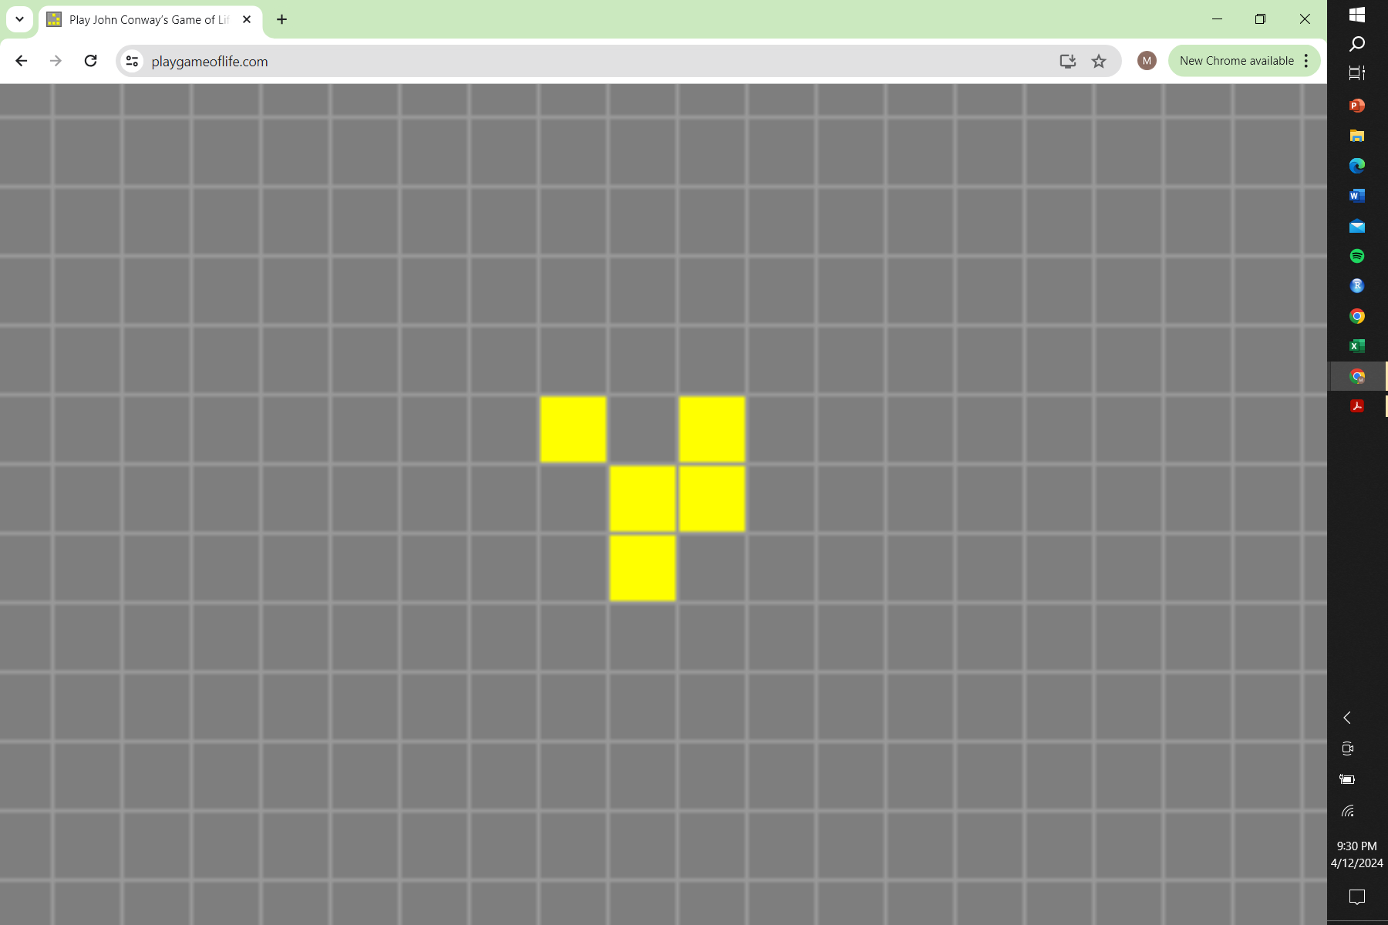
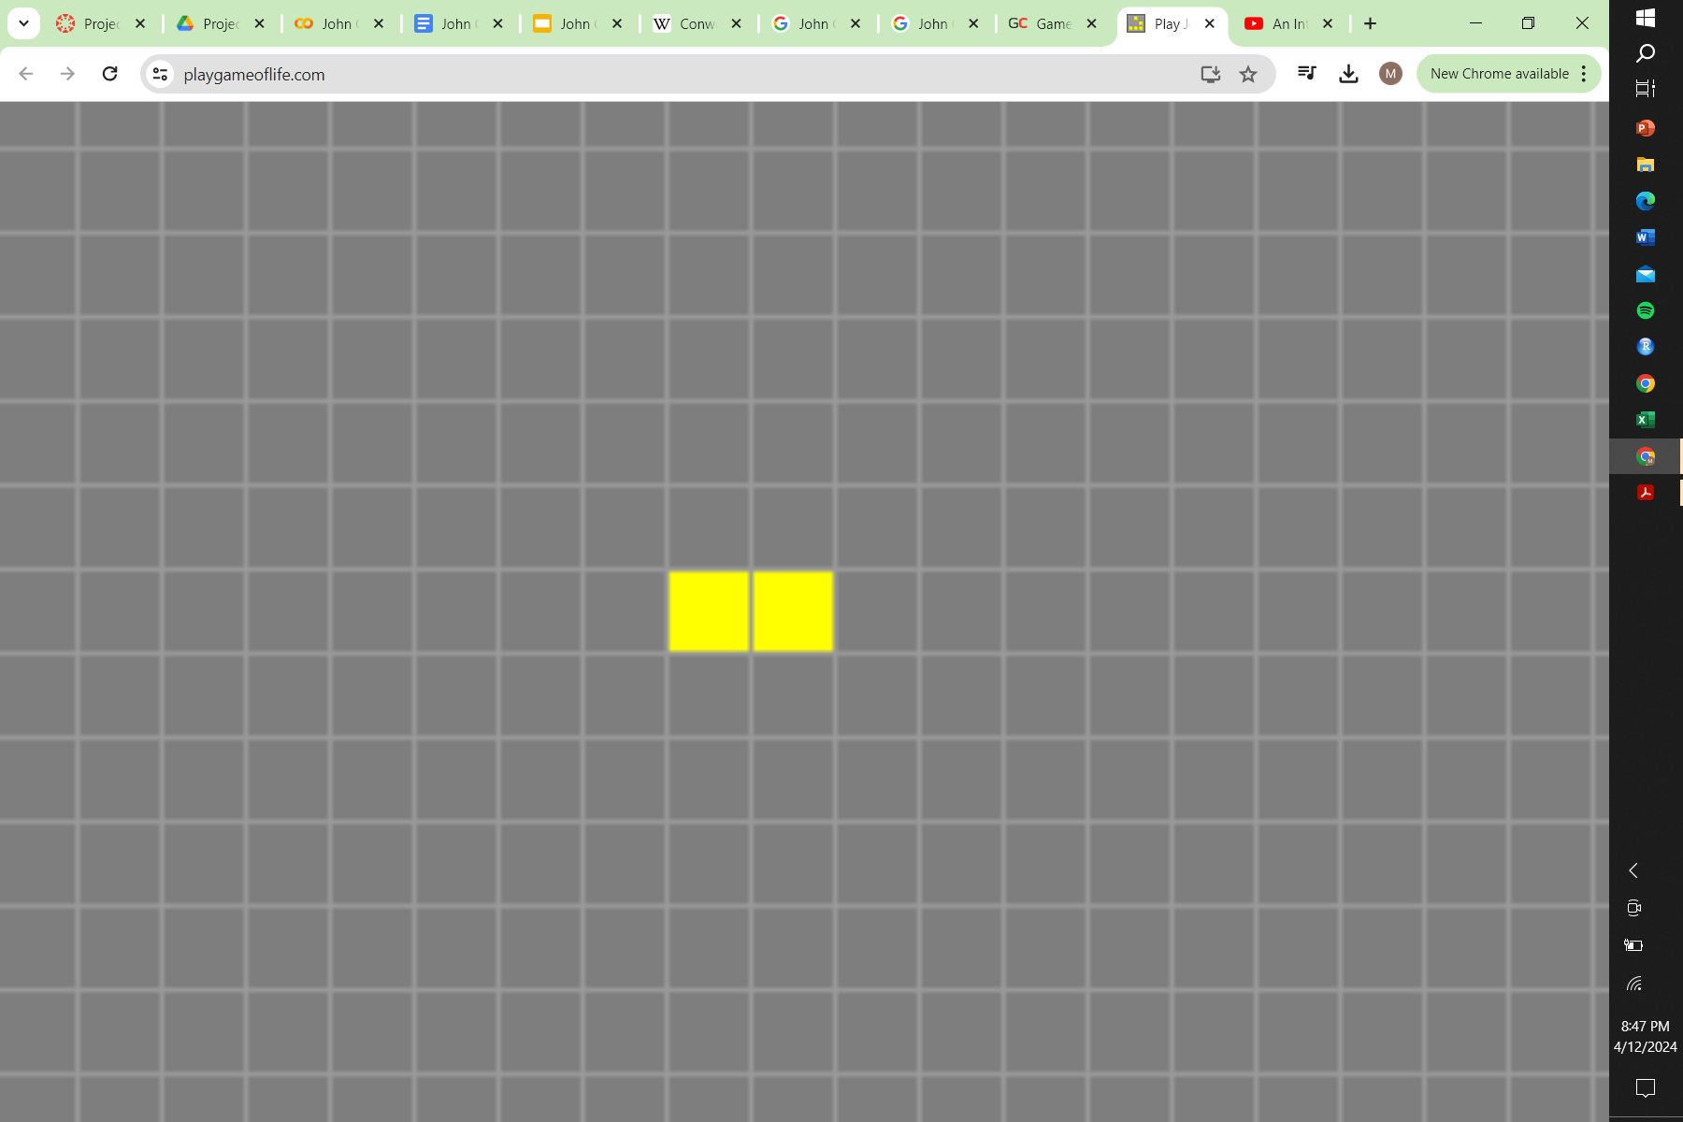
Rules of the Game
Deterministic - What is generated is determined by its random starting pattern
Any live cell with < 2 live neighbors dies, as if by underpopulation.
Any live cell with 2 or 3 live neighbors lives on to the next generation.
Any live cell with > 3 live neighbors dies, as if by overpopulation.
Any dead cell with == 3 neighbors becomes a live cell, as if by reproduction.
1
Alive cell
0
Dead cell

Slide 4
QUIZ TIME
Based of Conway's Game of Life Rules
What happens to the following cells in the next generation?

Slide 5
Q1: What happens to the following cells in the next generation?
RULES
Any live cell with < 2 live neighbors dies, as if by underpopulation.
Any live cell with 2 or 3 live neighbors lives on to the next generation.
Any live cell with > 3 live neighbors dies, as if by overpopulation.
Any dead cell with == 3 neighbors becomes a live cell, as if by reproduction.
Gen 1
Alive Cell
Dead Cell

Slide 6
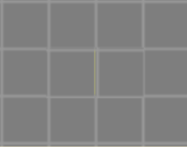
RULES
Any live cell with < 2 live neighbors dies, as if by underpopulation.
Any live cell with 2 or 3 live neighbors lives on to the next generation.
Any live cell with > 3 live neighbors dies, as if by overpopulation.
Any dead cell with == 3 neighbors becomes a live cell, as if by reproduction.
Gen 2
Alive Cell
Dead Cell

Slide 7
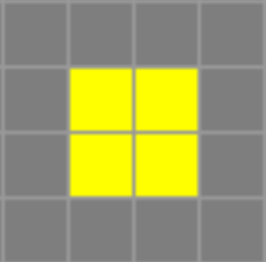
Q2: What happens to the following cells in the next generation?
RULES
Any live cell with < 2 live neighbors dies, as if by underpopulation.
Any live cell with 2 or 3 live neighbors lives on to the next generation.
Any live cell with > 3 live neighbors dies, as if by overpopulation.
Any dead cell with == 3 neighbors becomes a live cell, as if by reproduction.
Millennialss 1
Alive Cell
Dead Cell

Slide 8
RULES
Any live cell with < 2 live neighbors dies, as if by underpopulation.
Any live cell with 2 or 3 live neighbors lives on to the next generation.
Any live cell with > 3 live neighbors dies, as if by overpopulation.
Any dead cell with == 3 neighbors becomes a live cell, as if by reproduction.
Gen Z
Alive Cell
Dead Cell

Slide 9
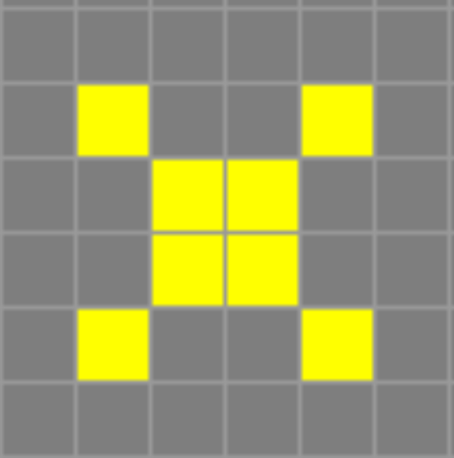
Q3: What happens to the following cells in the next generation?
RULES
Any live cell with < 2 live neighbors dies, as if by underpopulation.
Any live cell with 2 or 3 live neighbors lives on to the next generation.
Any live cell with > 3 live neighbors dies, as if by overpopulation.
Any dead cell with == 3 neighbors becomes a live cell, as if by reproduction.
Gen 1
Alive Cell
Dead Cell

Slide 10
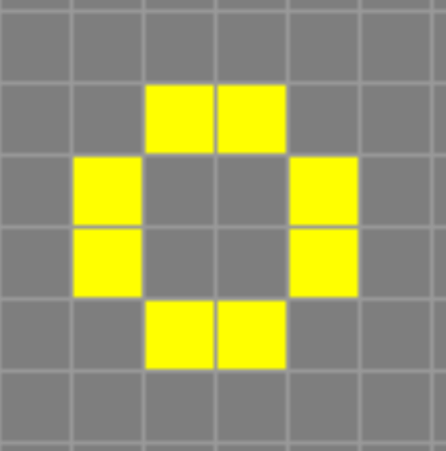
RULES
Any live cell with < 2 live neighbors dies, as if by underpopulation.
Any live cell with 2 or 3 live neighbors lives on to the next generation.
Any live cell with > 3 live neighbors dies, as if by overpopulation.
Any dead cell with == 3 neighbors becomes a live cell, as if by reproduction.
Gen 2
Alive Cell
Dead Cell

Slide 11
Okay, so we have pretty good idea of the rules of the game.
What is the point of the game?

Slide 12
A tiny amount of biology background before we get into the code

Slide 13
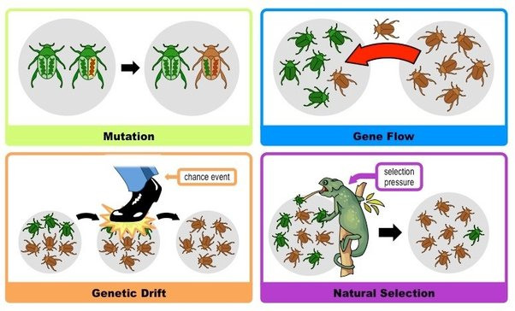
All the mechanisms of Evolution

Slide 14
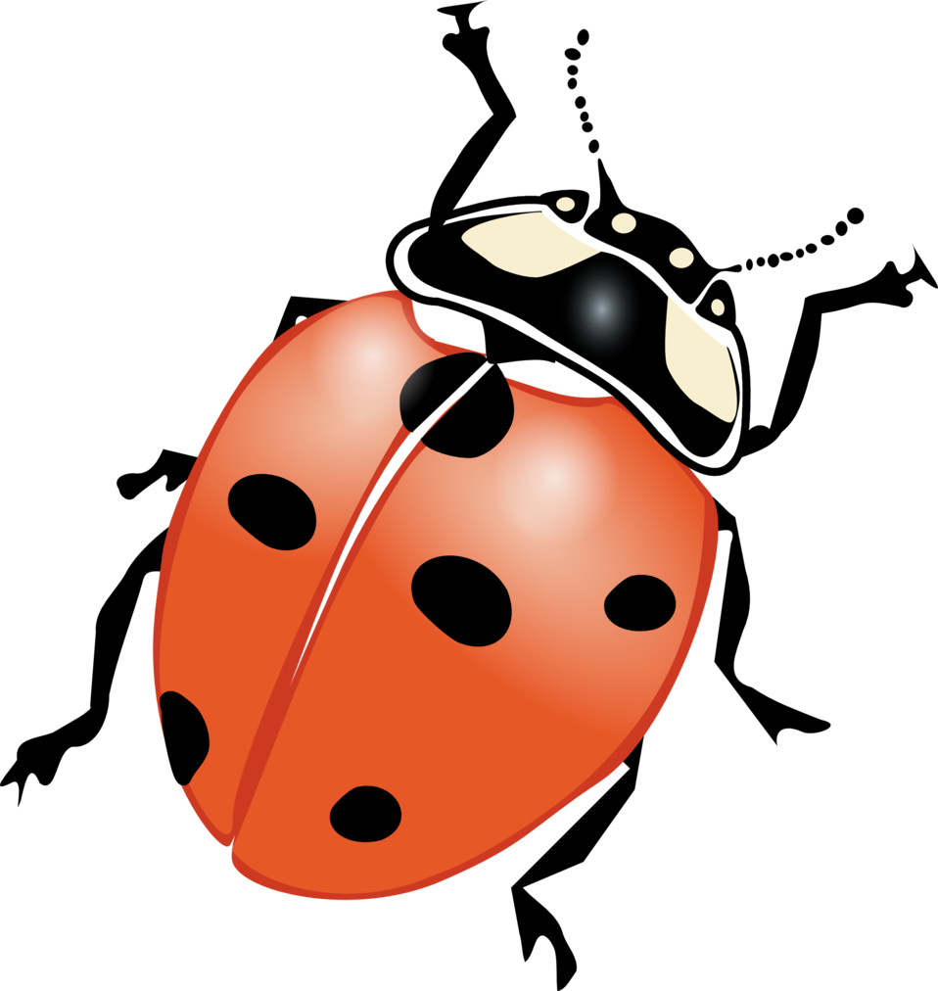
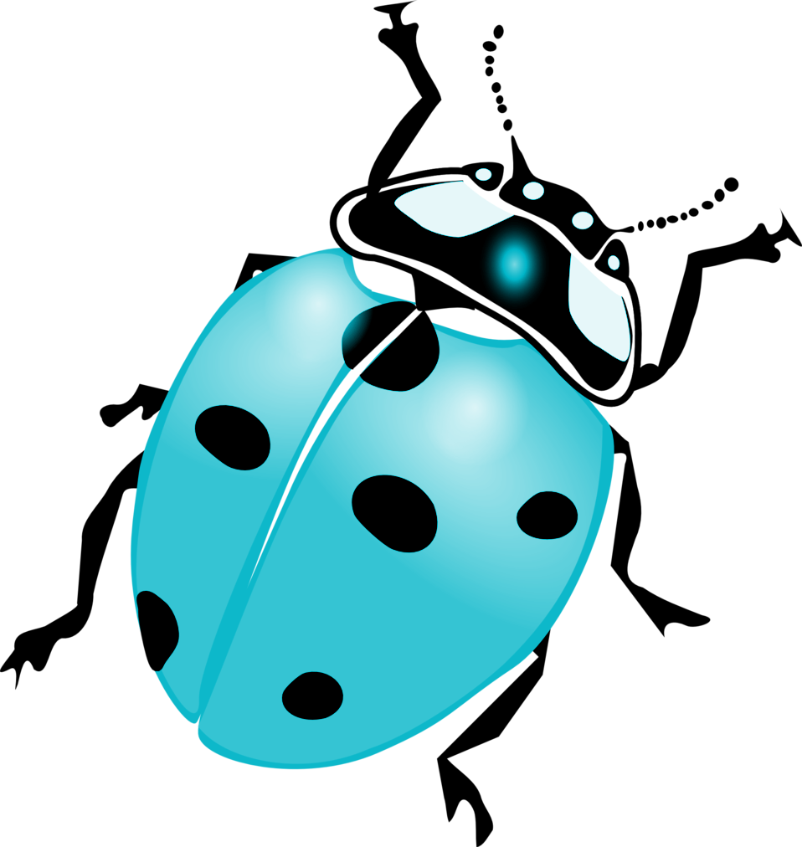
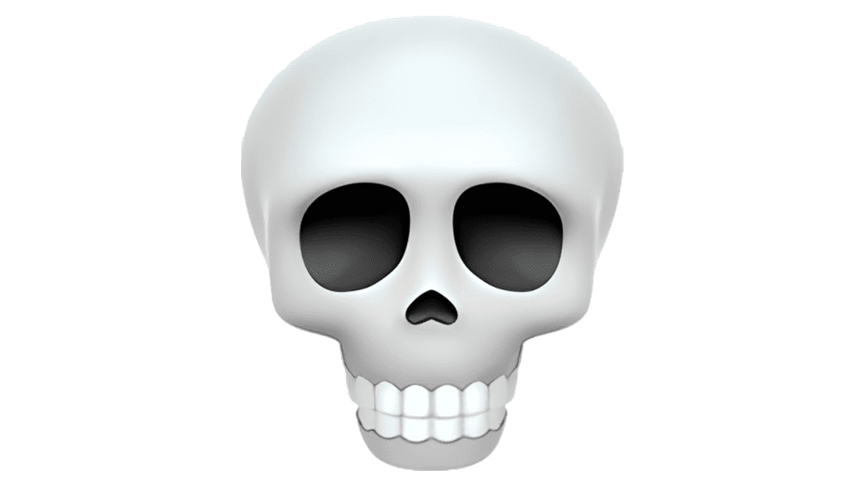

Using Cellular Automata to model change in pop. alleles over time
Populations can have different alleles (red or blue beetle) which can change due to different mechanisms of evolution (ie Genetic Drift, Natural Selection, Mutation, Gene Flow)
Generation 1
A RANDOM EVENT
Generation 2

Slide 15


One last important biological concept
Fitness is quantitative representation of individuals reproductive success. It is equal to the average contribution an individual's genes to the next generation
Gorgui I’m sure has a nice personality, but produced 0 children in his life
Prad Bitt was really popular with the ladies and had 5 children
Lower fitness
Higher fitness

Slide 16
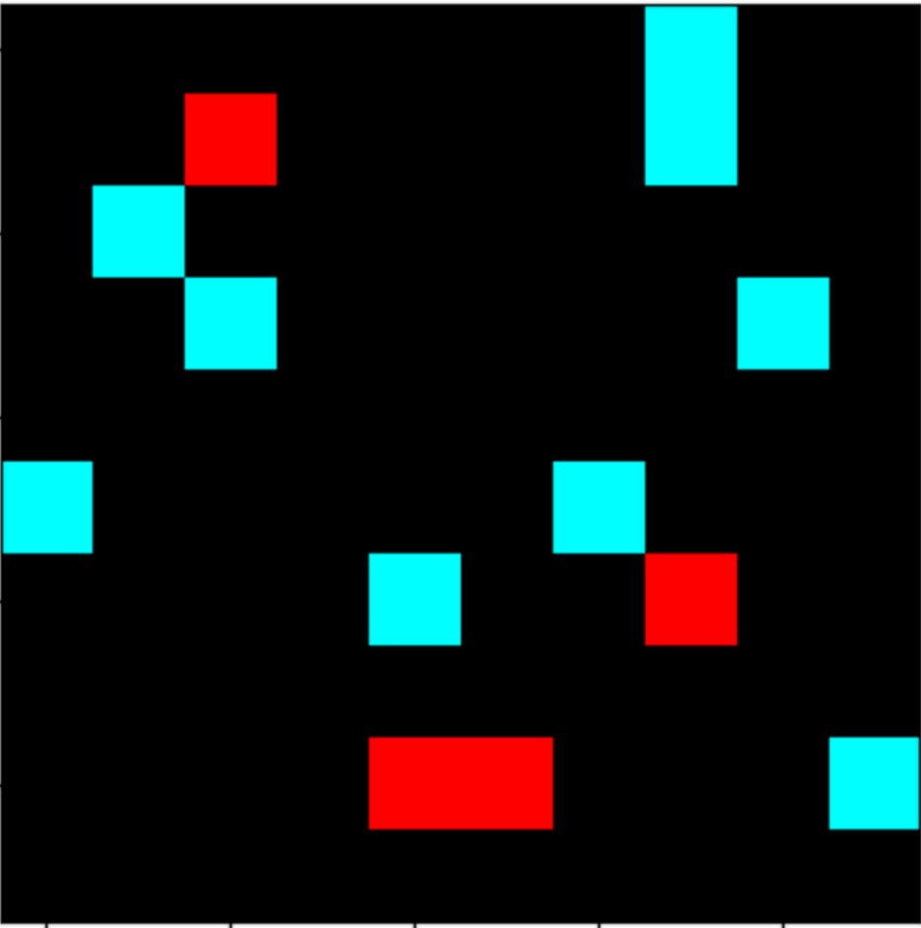
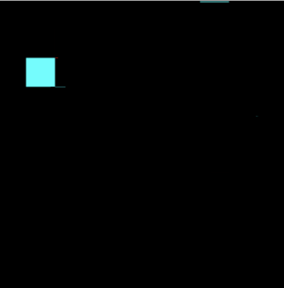
How do we represent different alleles and fitness in the game?
Colors + Relative Frequency
Gen 1
Gen 1
Gen 2
0/1 = 0
fitness
1/1 = 1
fitness

Slide 17
Breaking down the The Code (4 Phases)
Phase 1 - Remember this is deterministic, so we must start by creating the starting population (our organisms have no free will)
Phase 2 - Introducing Fitness Calculation, Mutations, and Inheritance
Phase 3 - Rules for updating the grid for each generation (Conway’s Rules)
Phase 4 - # of generation parameters and saving each grid generated together as gif

Slide 18
Phase 1 - Remember this is deterministic, so we must start by creating the starting population
Initialize the Grid Environment + Population
How many alleles(colors) in population
What are the alleles relative frequency?

Slide 19
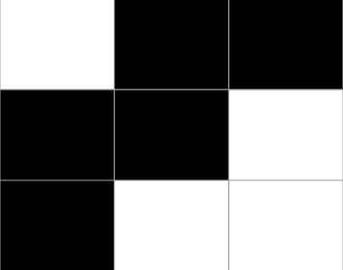
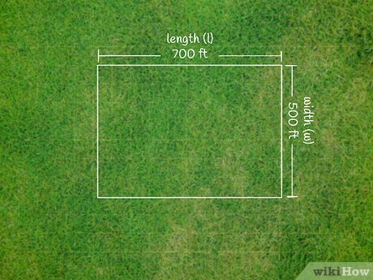
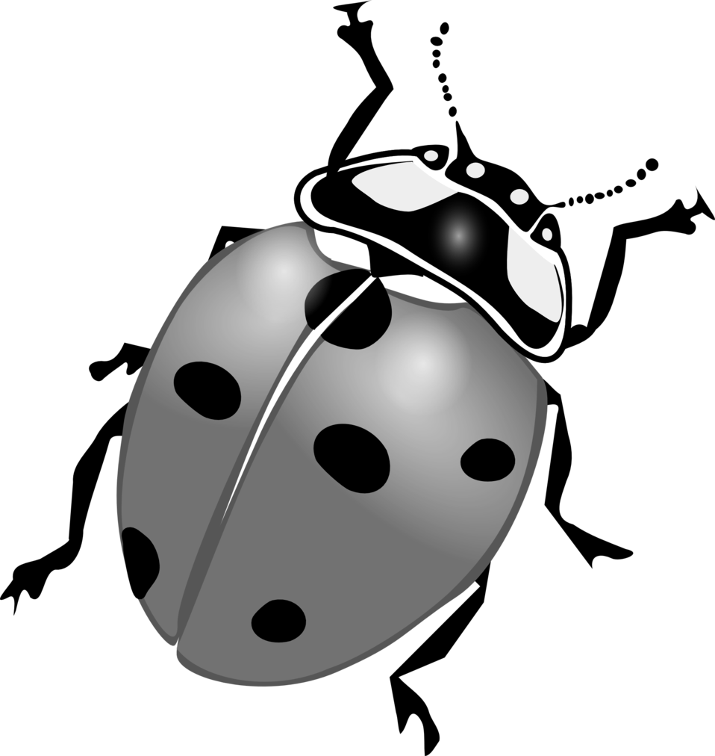
Initialize the Grid Environment + Population
The grid must consist of a height, width, and cells that have one of two states: Alive or Dead. The population density or overall frequency of organisms in environment also must be specified.
width
dead
height
alive
The presence of beetles was detected in 4 out of the 9 grids ~ 0.44 population density

Slide 20
How many alleles(colors) in population
Alive cells will have a color associated with it representing an alleles in that population. Dead cells will be black. For example if there are 2 alleles in the population:
Dead
RGB value = (0,0,0)
Allele 1
RGB value = (0,255,255)
Allele 2
RGB value = (255,0,0)

Slide 21
What are the alleles relative frequency?
The relative frequency is the percentage of “alive cells” are one allele or another. This takes the number given from population density and assigns each cell a color given the relative frequencies
Population density is 0.44, or 4/9 squares.
Relative frequency is 0.5 blue and 0.5 red. So there will be 2 squares red and 2 squares blue

Slide 22
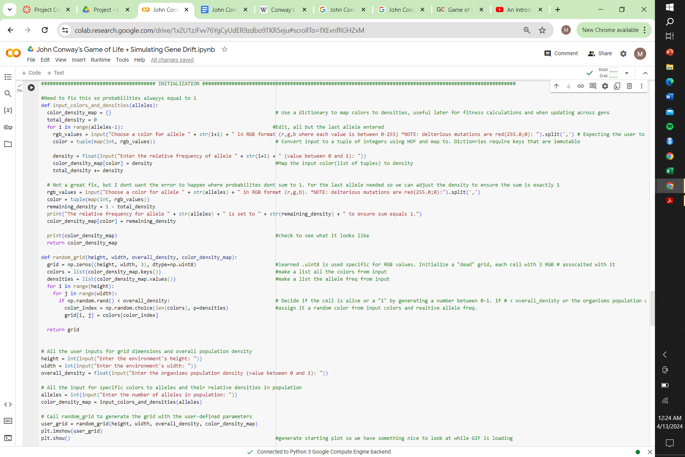
User Input

Slide 23
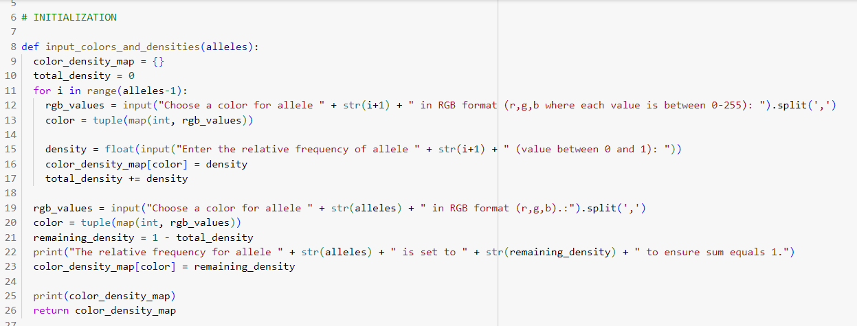
Creating a dictionary that attributes {Color: relative frequency}
Example: { (255,0,0):0.5, (0,255,255):0.5}
{(red):red’s frequency, (blue):blue’ frequency)

Slide 24
Grid Initialization
Color density map:
{(255,0,0):0.5, (0,255,255):0.5}
Keys = [(255,0,0),(0,255,255)] = color
Values = [0.5, 0.5] = relative freq.
From colors random choose based off relative frequency
Initialize blank
Overall density = 0.44 > (rand 0-1)
(0,0,0) | (0,0,0) | (0,0,0)
(0,0,0) | (0,0,0) | (0,0,0)
(0,0,0) | (0,0,0) | (0,0,0)
(alive!) | (0,0,0) | (0,0,0)
(0,0,0) | (0,0,0) | (alive!)
(0,0,0) | (alive!) | (alive!)
(255,0,0) | (0,0,0) | (0,0,0)
(0,0,0) | (0,0,0) | (0,255,255)
(0,0,0) | (0,255,255) | (255,0,0)

Slide 25
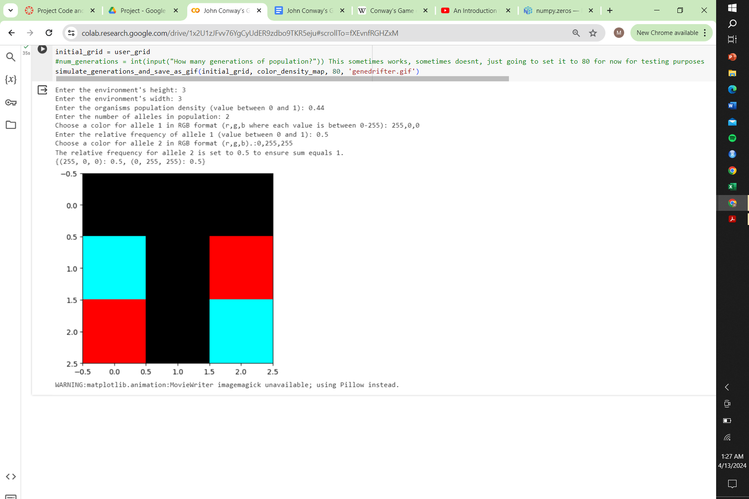
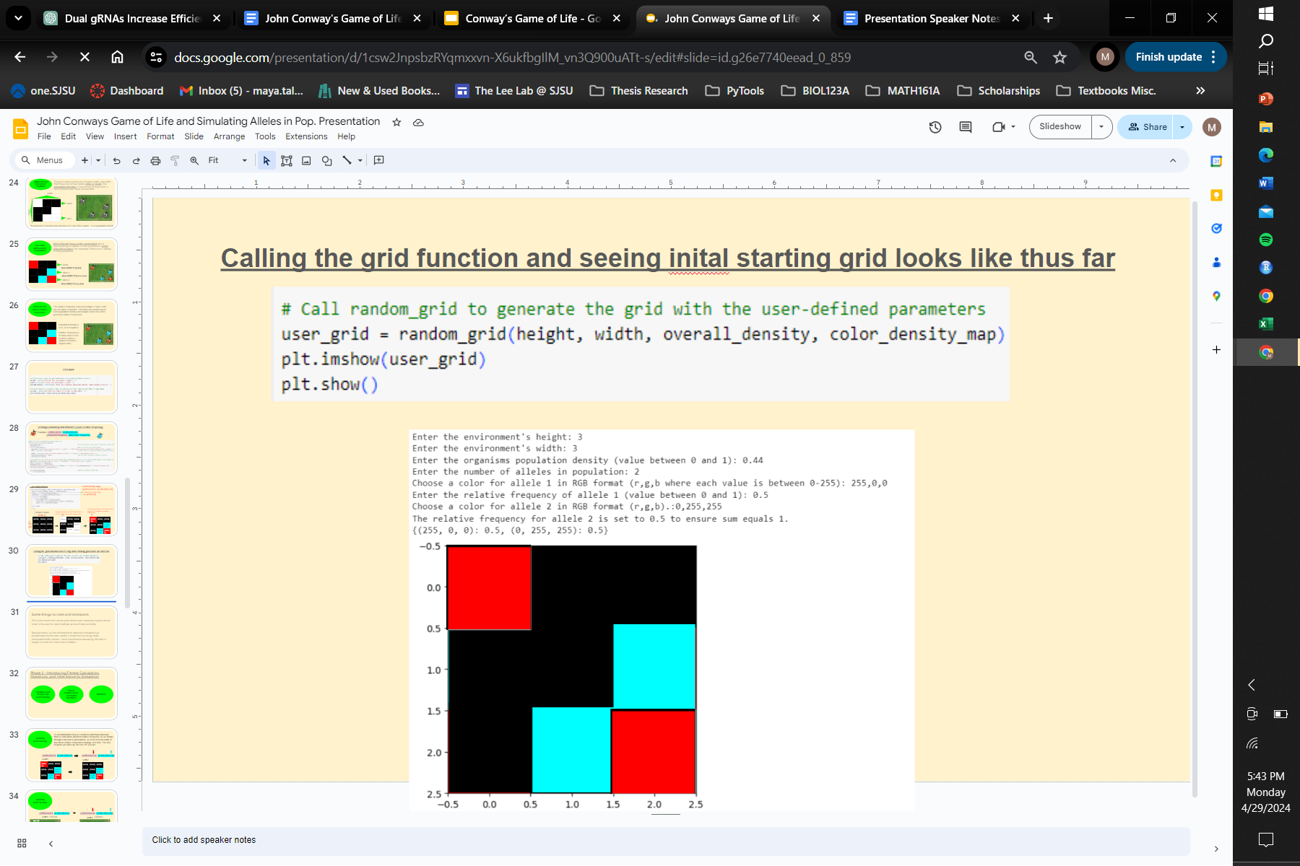
Calling the grid function and seeing initial starting grid looks like thus far

Slide 26
Some things to note and limitations
Error prone
Because there is a lot of freedom to make the simulation as complicated & could end up being really computationally intense

Slide 27
Phase 2 - Introducing Fitness Calculation, Mutations, and Inheritance to Simulation
Updating color density map {color:density}
Fitness, weighted sums, and hybrid inheritance
Mutations

Slide 28
Updating color density map {color:density}
Initialization step: dictionary that kept track of each allele and their relative frequency.
As we iterate through generations, we need to keep a tally of how these relative frequencies change over time. The less frequent you show up, the less “fit” you are.
{ (255,0,0):0.5, (0,255,255):0.5}
{ (255,0,0):0.33, (0,255,255):0.66}
Gen 1 Parents
Gen 2 Children
Notes:
Fitness tied to density

Slide 29
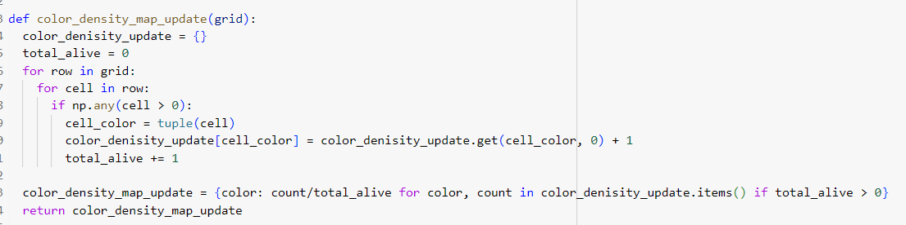
{ (255,0,0):0.5, (0,255,255):0.5}
{ (255,0,0):0.33, (0,255,255):0.66}
Gen 1
Gen 2
(255,0,0) | (0,0,0) | (0,0,0)
(0,0,0) | (0,0,0) | (0,255,255)
(0,0,0) | (0,255,255) | (255,0,0)
(0,0,0) | (0,0,0) | (0,0,0)
(0,0,0) | (0,0,0) | (0,255,255)
(0,0,0) | (0,255,255) | (255,0,0)
Notes:
Code iterates through all cells
Sees if it’s alive or dead
If alive -> what color?
That color added to empty dictionary
+1 for alive color
+1 for total density
Does it for all colors to recalculates frequencies

Slide 30
Hybrids are the merging of two colors.
The higher your fitness (relative frequency) the more influence your color contributes to offspring.
Computed by a weighted average instead of a traditional average
Fitness, weighted sums, and hybrid inheritance
{ (255,0,0):0.33, (0,255,255):0.66}
{ (255,0,0):0.25, (0,255,255):0.50, (84,168,168):0.25 }
Gen 2
Gen 3
(0,0,0) | (0,0,0) | (0,0,0)
(0,0,0) | (0,0,0) | (0,255,255)
(0,0,0) | (0,255,255) | (255,0,0)
(0,0,0) | (0,0,0) | (0,0,0)
(0,0,0) | (84,168,168) | (0,255,255)
(0,0,0) | (0,255,255) | (255,0,0)
Notes:
How child cells inherit colors from their parents

Slide 31
Parent R= (255 x 0.33) + (0 x 0.66) = 84.15
Parent G = (0 x 0.33) + (255 x 0.66) = 168.3
Parent B = (0 x 0.33) + (255 * 0.66) = 168.3
New child RGB value = (84,168,168)
Fitness, weighted sums, and hybrid inheritance
New colors that appear are tracked in the color_denisty_map update
{ (255,0,0):0.33, (0,255,255):0.66}
{ (255,0,0):0.25, (0,255,255):0.50, (84,168,168):0.25 }
Gen 2
Gen 3
(0,0,0) | (0,0,0) | (0,0,0)
(0,0,0) | (0,0,0) | (0,255,255)
(0,0,0) | (0,255,255) | (255,0,0)
(0,0,0) | (0,0,0) | (0,0,0)
(0,0,0) | (84,168,168) | (0,255,255)
(0,0,0) | (0,255,255) | (255,0,0)
Notes:
The way fitness is calculated is a weighted average of their RBG values
Because there is 66% more blue there will be more a higher blue average

Slide 32
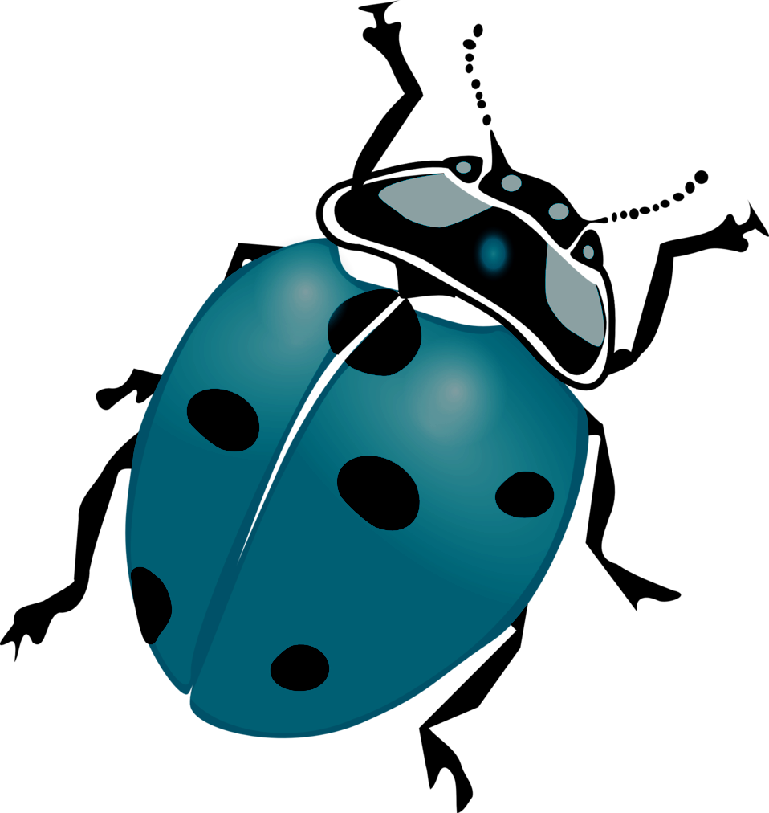
Parent R= (255 x 0.33) + (0 x 0.66) = 84.15
Parent G = (0 x 0.33) + (255 x 0.66) = 168.3
Parent B = (0 x 0.33) + (255 * 0.66) = 168.3
New child RGB value = (84,168,168)
Fitness, weighted sums, and hybrid inheritance
New colors that appear are tracked in the color_denisty_map update
{ (255,0,0):0.33, (0,255,255):0.66}
{ (255,0,0):0.25, (0,255,255):0.50, (84,168,168):0.25 }
Gen 2
Gen 3

Slide 33
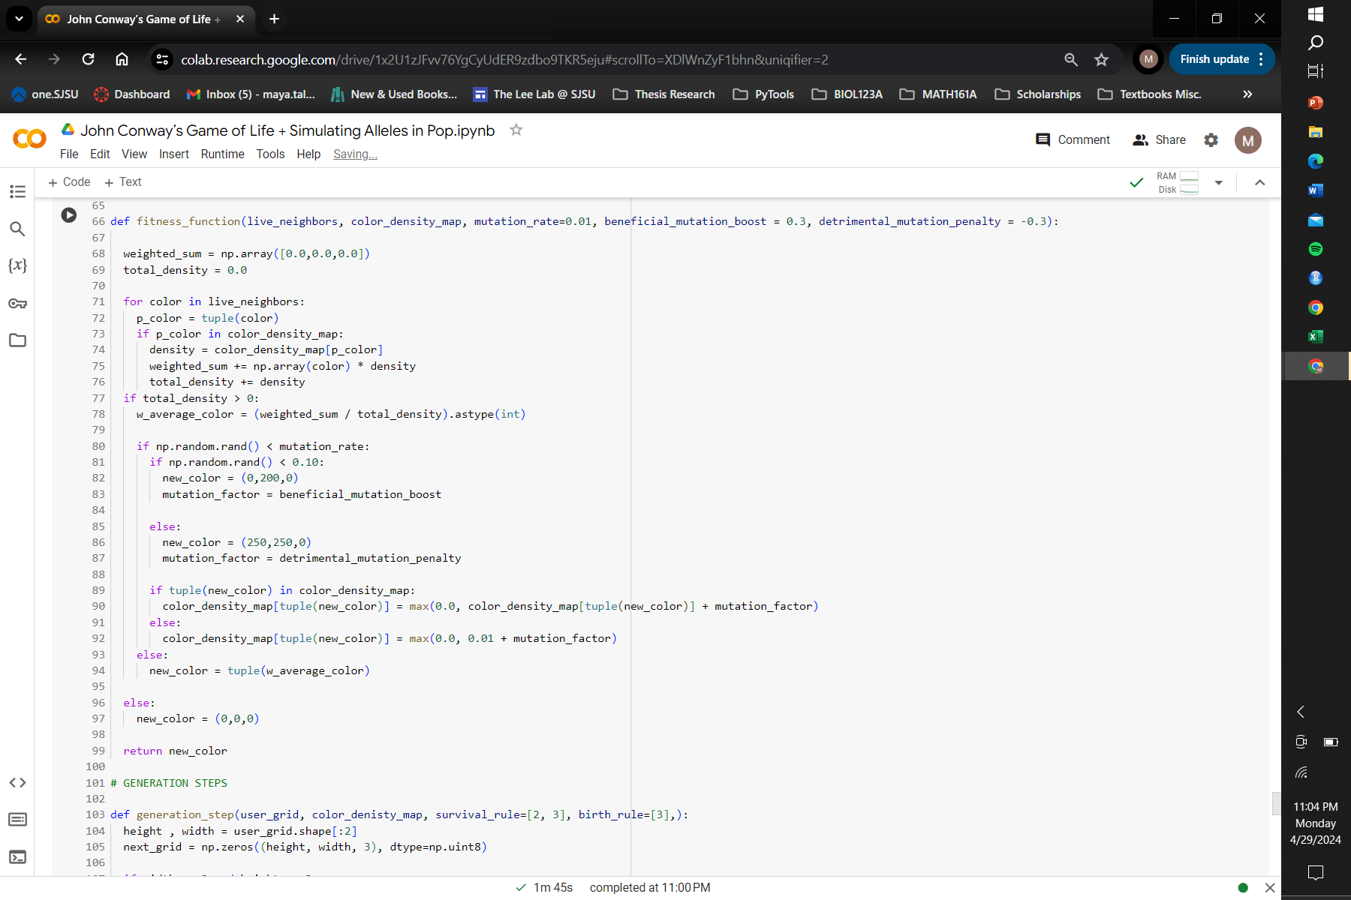
(0,0,0) | (0,0,0) | (0,0,0)
(0,0,0) | (84,168,168) | (0,255,255)
(0,0,0) | (0,255,255) | (255,0,0)
R p_color: (255 x 0.33) + (0 x 0.66) = 84.15
G p_color: (0 x 0.33) + (255 x 0.66) = 168.3
B p_color: (0 x 0.33) + (255 * 0.66) = 168.3
w_average_color = (84,168,168)
Notes:
Weighted sum (placeholder for babies color)
Total_density
Both set to 0
iterate over parent color/rbg values
if parent color exist in dictionary -> get the density frequency
multiply the parent color by the density giving it more weight, and add to weighted sum. add density to total
Store original densities
If new color is in color density map then the code calculates weighted sum

Slide 34
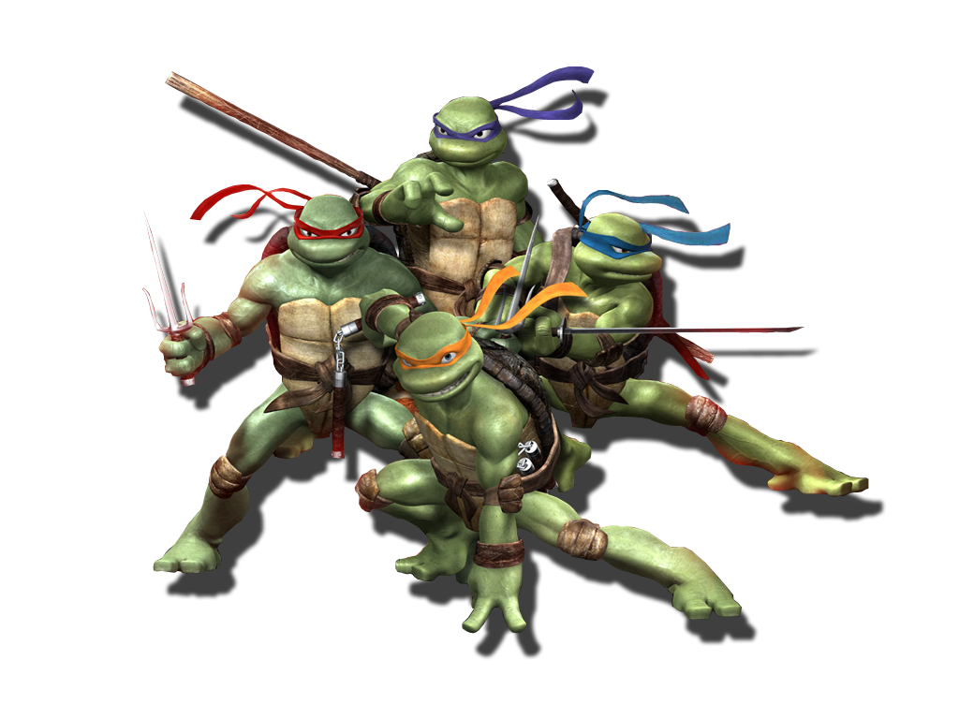
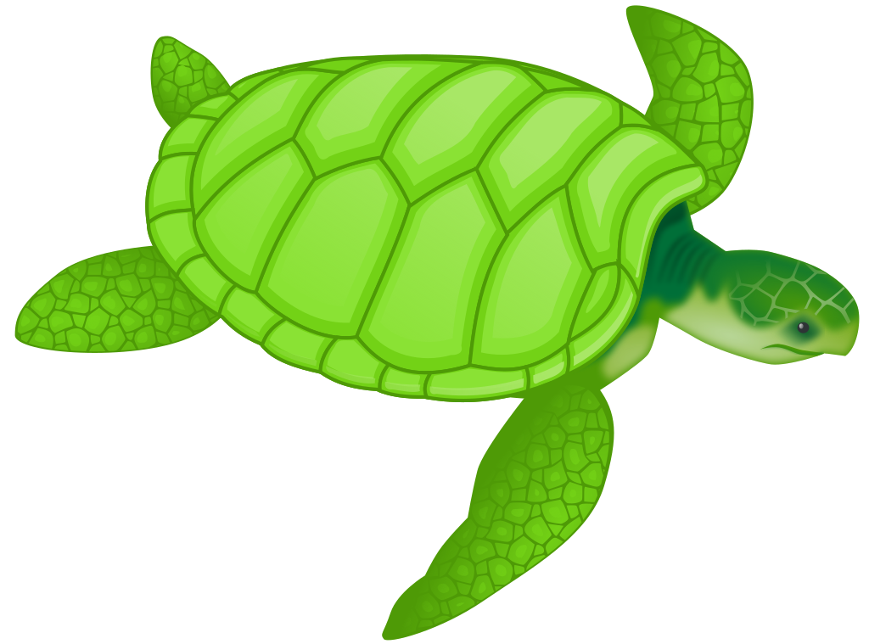
Mutation
Mutations happen randomly and introduce genetic diversity
Mutations are often bad, but good mutations possible.
To represent mutations there are two hardcoded colors which were chosen to represent good and bad mutations

Slide 35
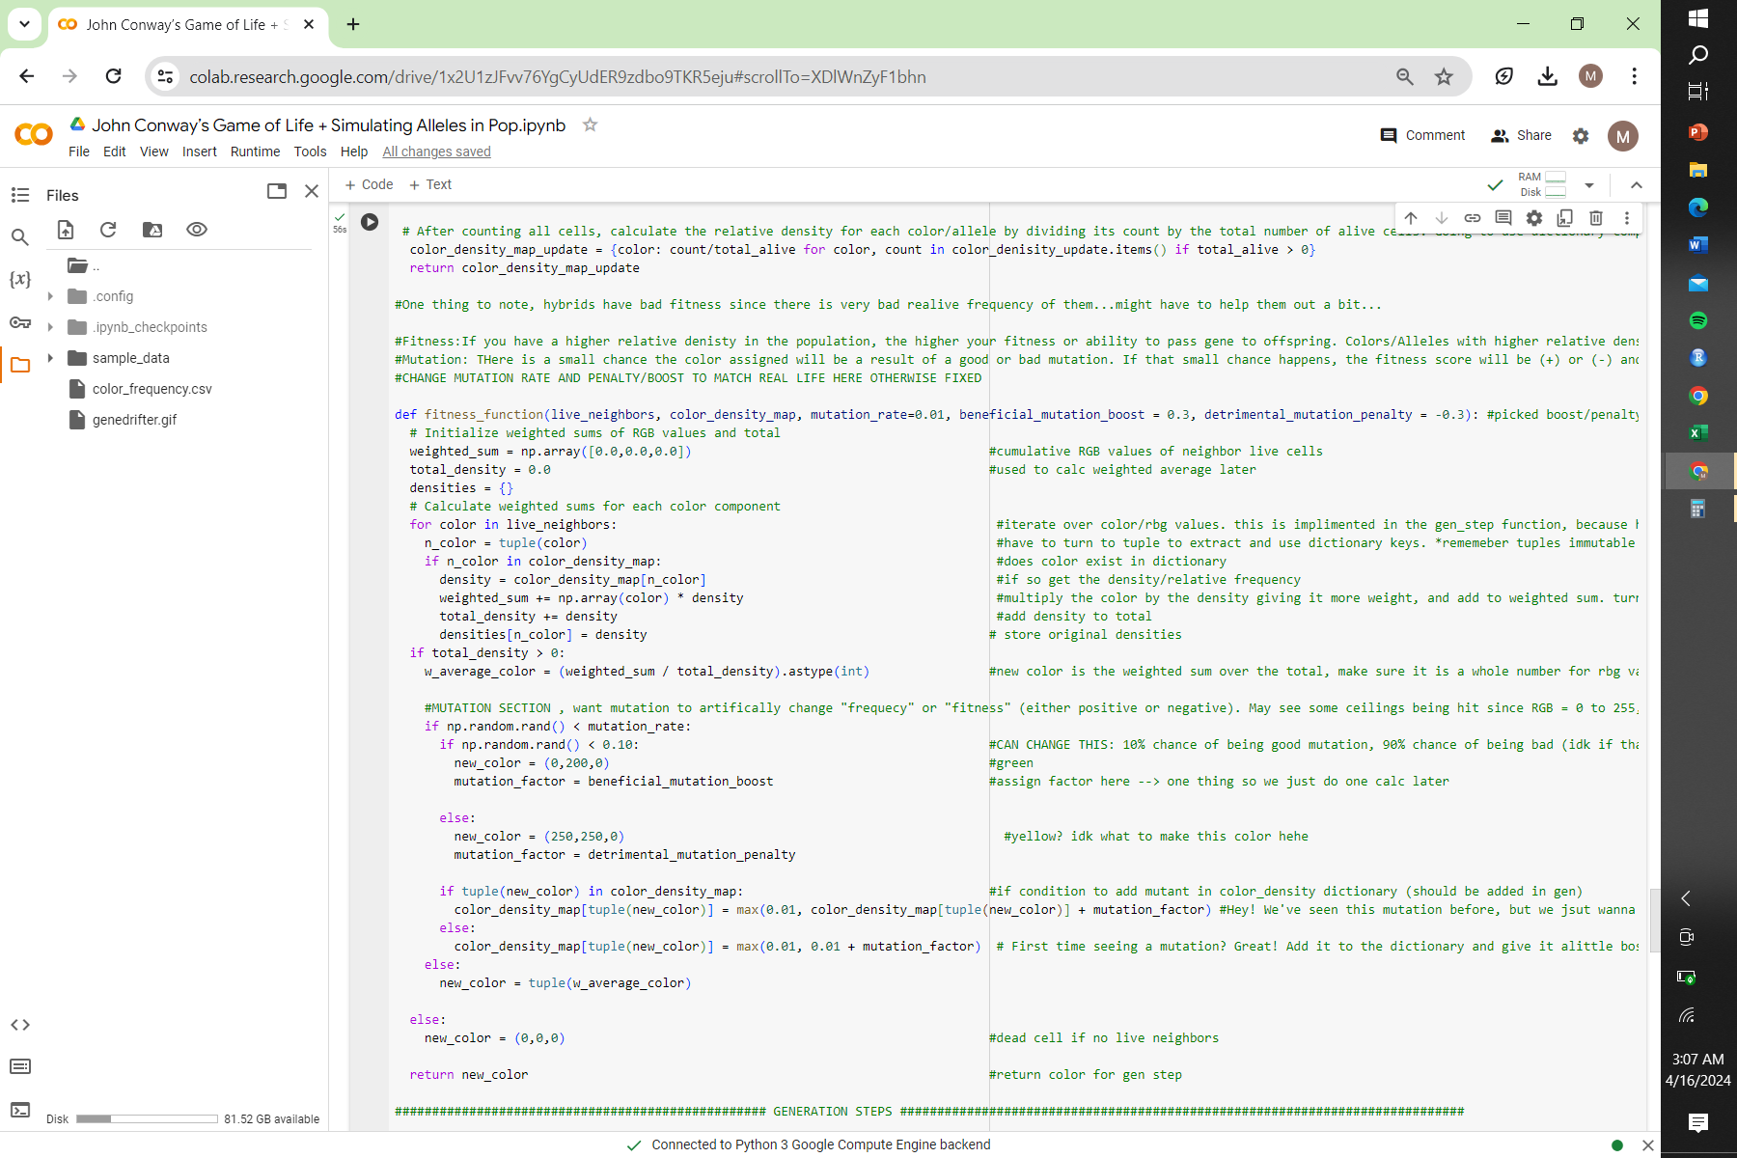
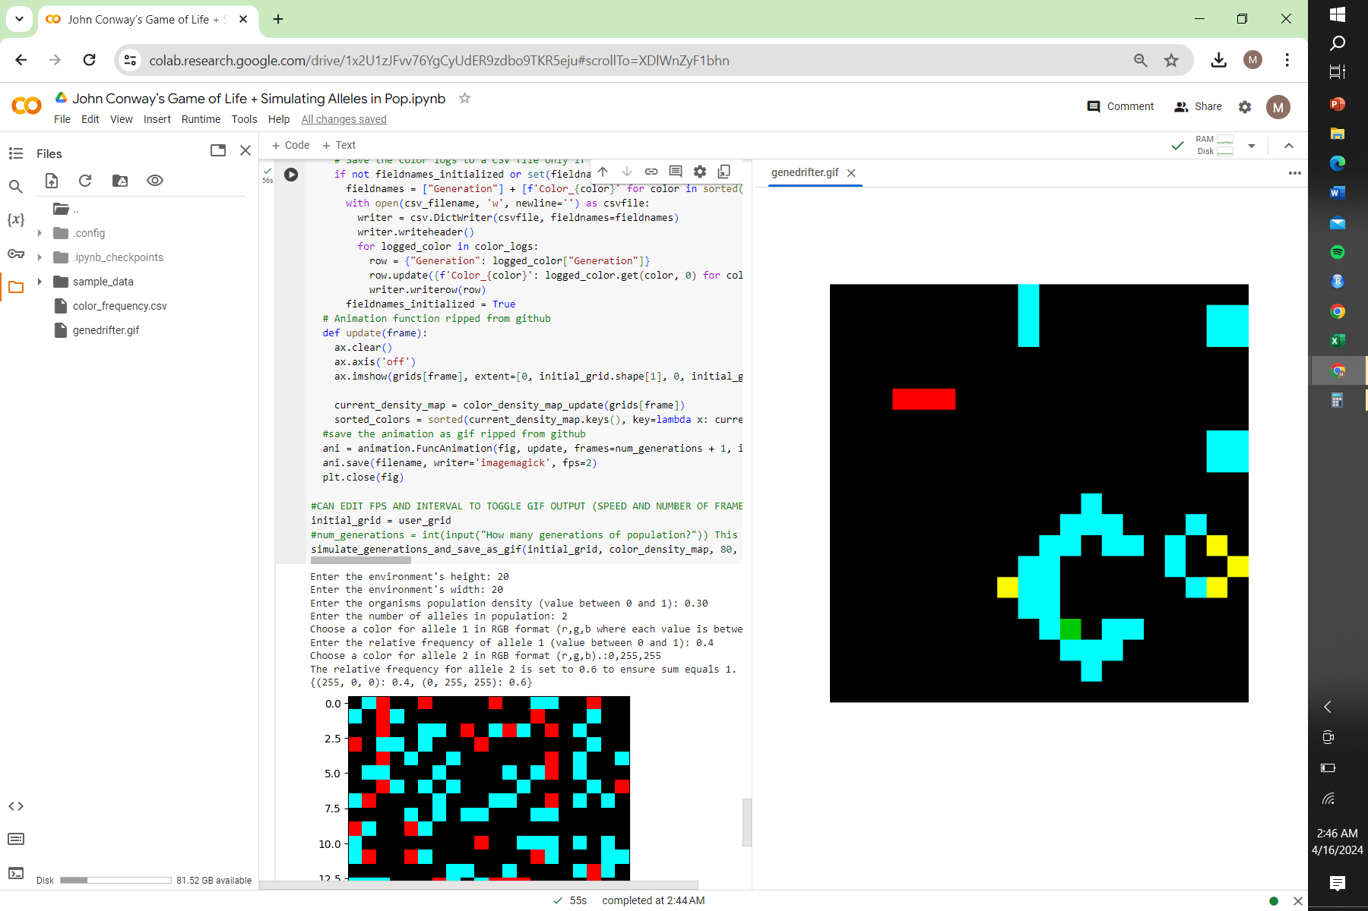
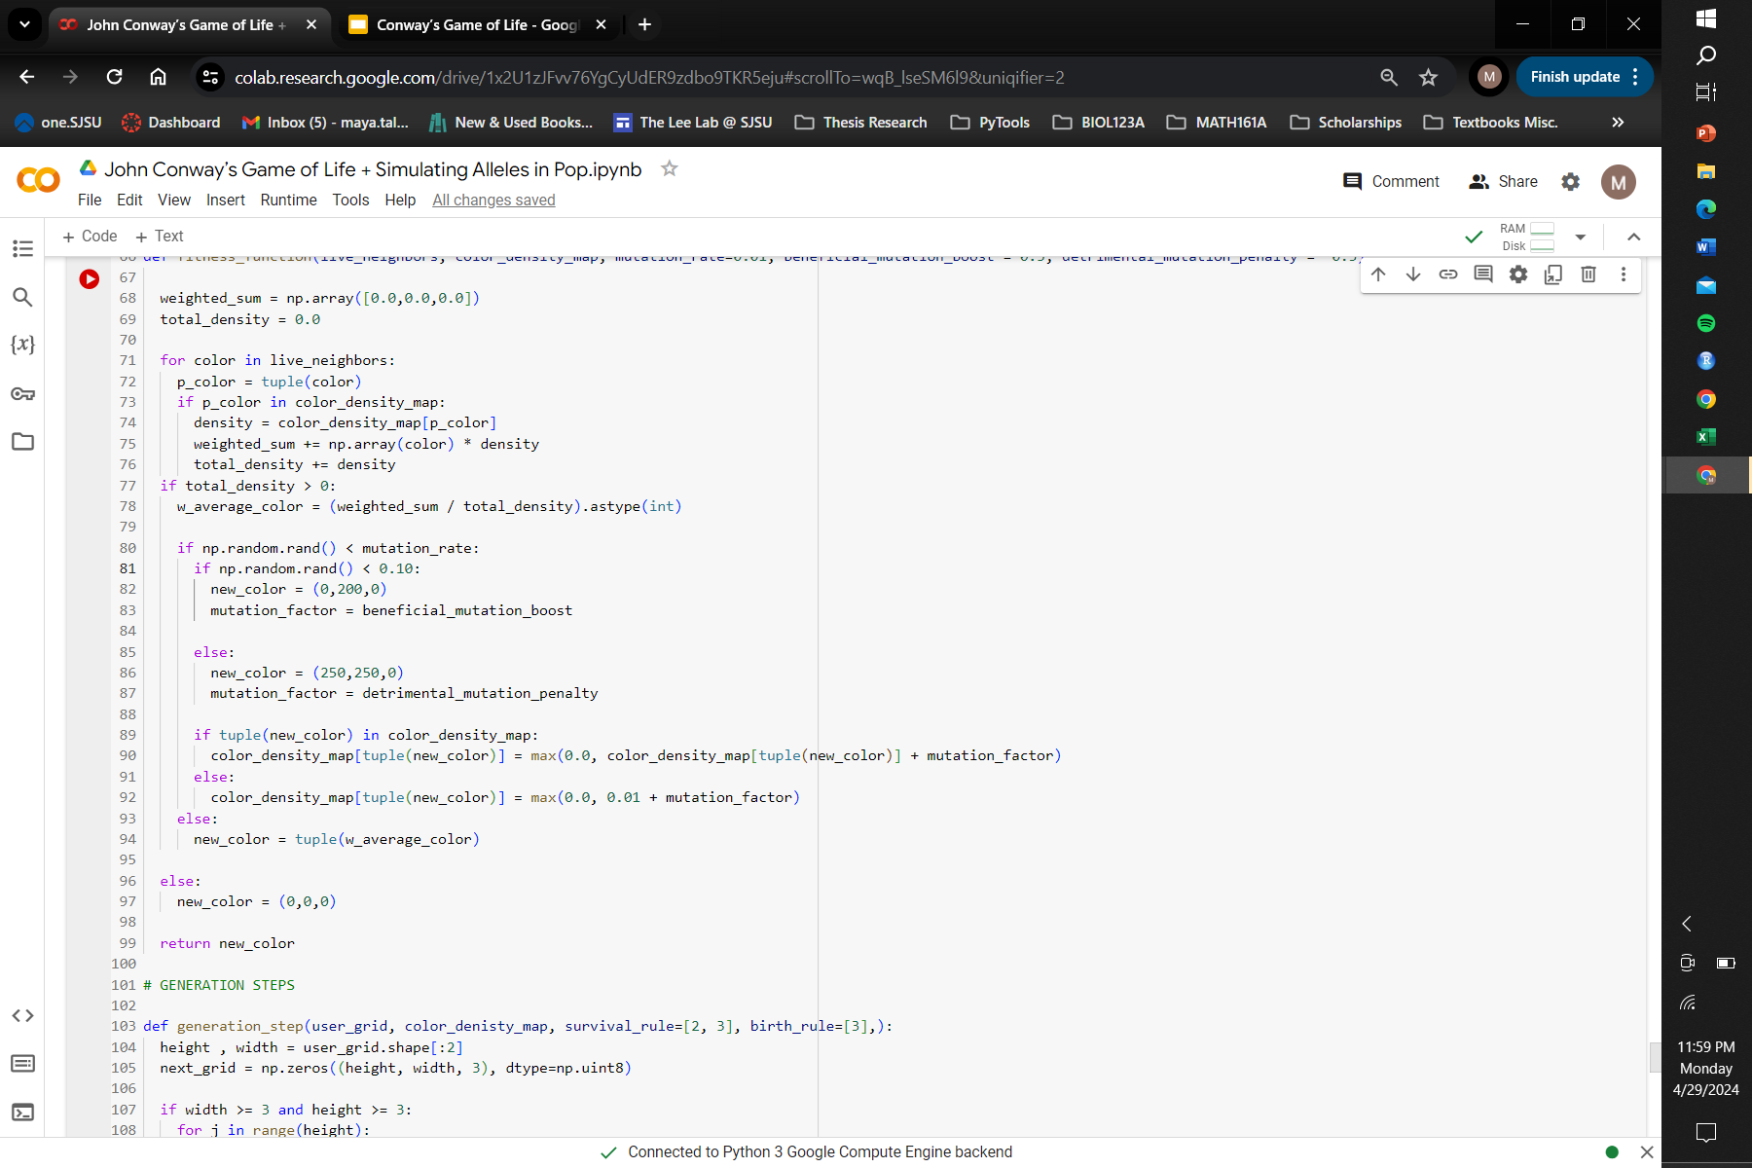
(0,0,0) | Bad mutant | (0,0,0)
(0,255,255) | (0,0,0) | (0,255,255)
(0,0,0) | Good mutant | (255,0,0)
Cons: most things in mutations section are hard coded
Notes:
Picked green and yellow
Each cell that is “born” has a 1% chance of being a mutant (mutation rate).
Of the 0.01 mutants, 10% are good & 90% are bad
The mutant color is added to the {color:density} dictionary. An artificial boost to relative frequency/fitness is given to them.
They also cannot drop below 0.01 (or be negative) despite a penalty to fitness given to bad mutations. Mutations follow the same inheritance rules as wild type.

Slide 36
Phase 3 - Updating the grid for each generation
Initializing new blank grid
Conway's Rules
Implementing FItness Function

Slide 37
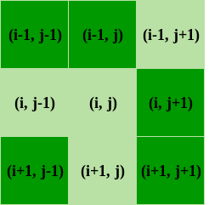
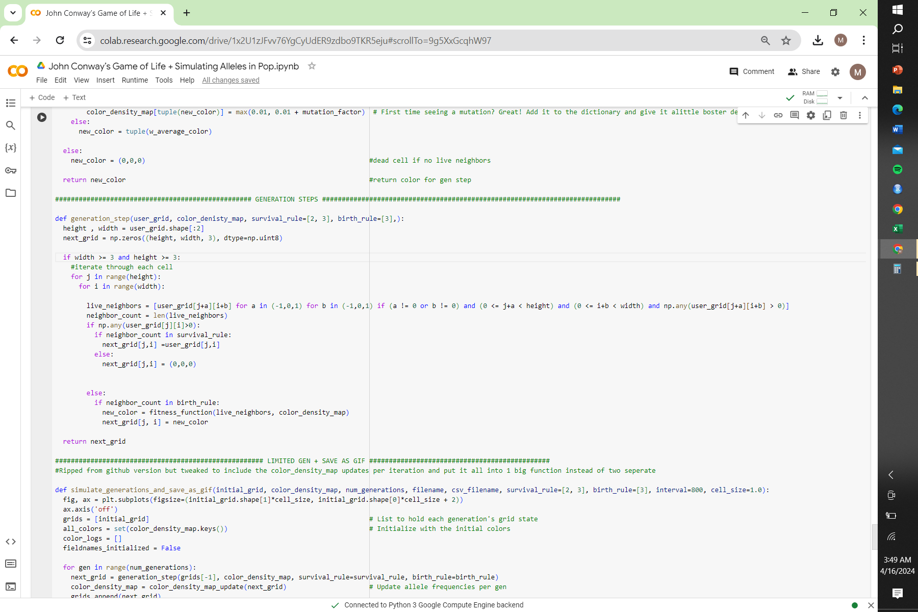
Initializing new blank grid

Slide 38
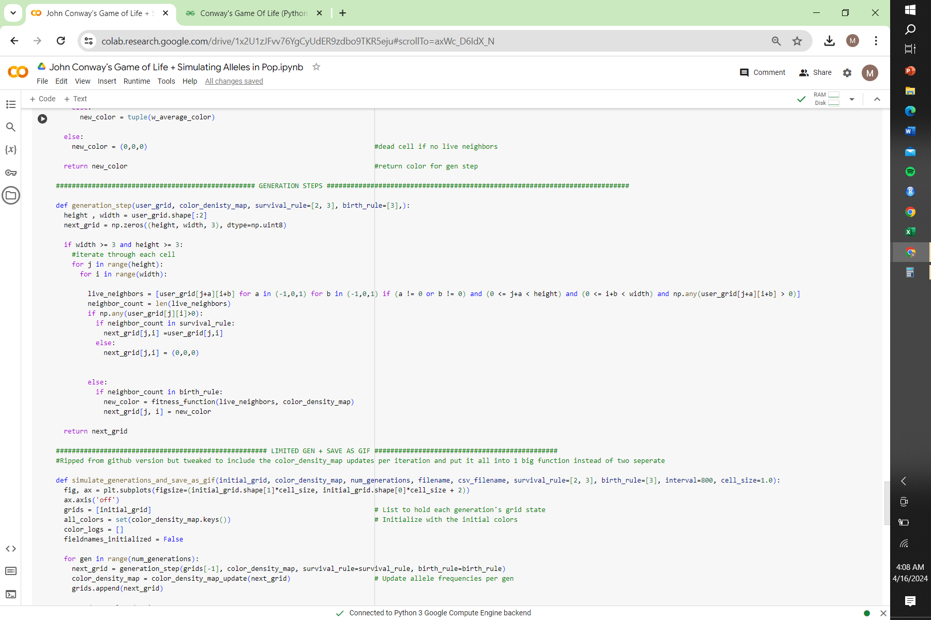
Conway's Rules
if:
Any live cell with 2 or 3 live neighbors lives on to the next generation.
else:
Any live cell with < 2 live neighbors dies, as if by underpopulation
or
Any live cell with > 3 live neighbors dies, as if by overpopulation.
(HAS TO BE EXACT 2 or 3)
Notes:
LC for live neighbors to return list of live neighbors (duh) bunch of rules for neighbor to be within bounds of grid, actually alive, and not count the actual cell were iterating upon currently
How many neighbors? Count them in len of the list!
If cell is alive in ise grid and neighbor count is 2 or 3 → it lives and next_grid is user_grid
If more or less ir dies :( next grid is (0,0,0) or black!

Slide 39
If:
Any dead cell with == 3 neighbors becomes a live cell, as if by reproduction.
Birthed cells’ color is determined by fitness function() from before
Conway's’ Rule- Birth and FItness Function

Slide 40
Phase 4 - Generational parameters and saving each grid together as gif, collecting {color:density} data
Generational Parameters
Saving .csv file
GIF

Slide 41
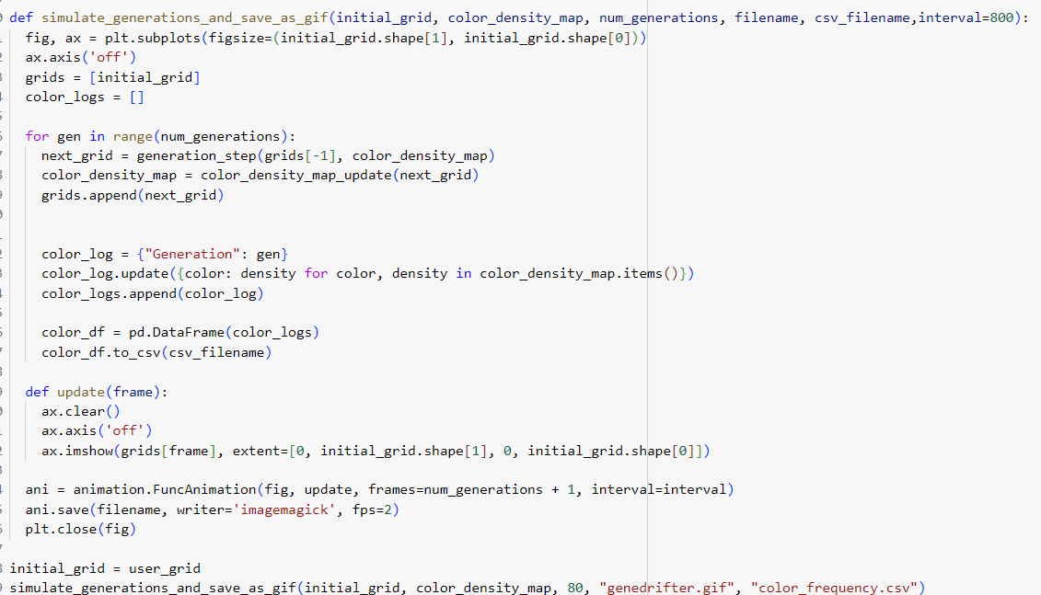
Notes:
This the meat and bone of the program
determines how many generations are gonna play out
This is hardcoded and
Ours is set to 80 generations
Empty list for each generations that stores all of the dif colors and density that pop up to be saved in a csv file
Update function updates grid to be saved as a gif later

Slide 42

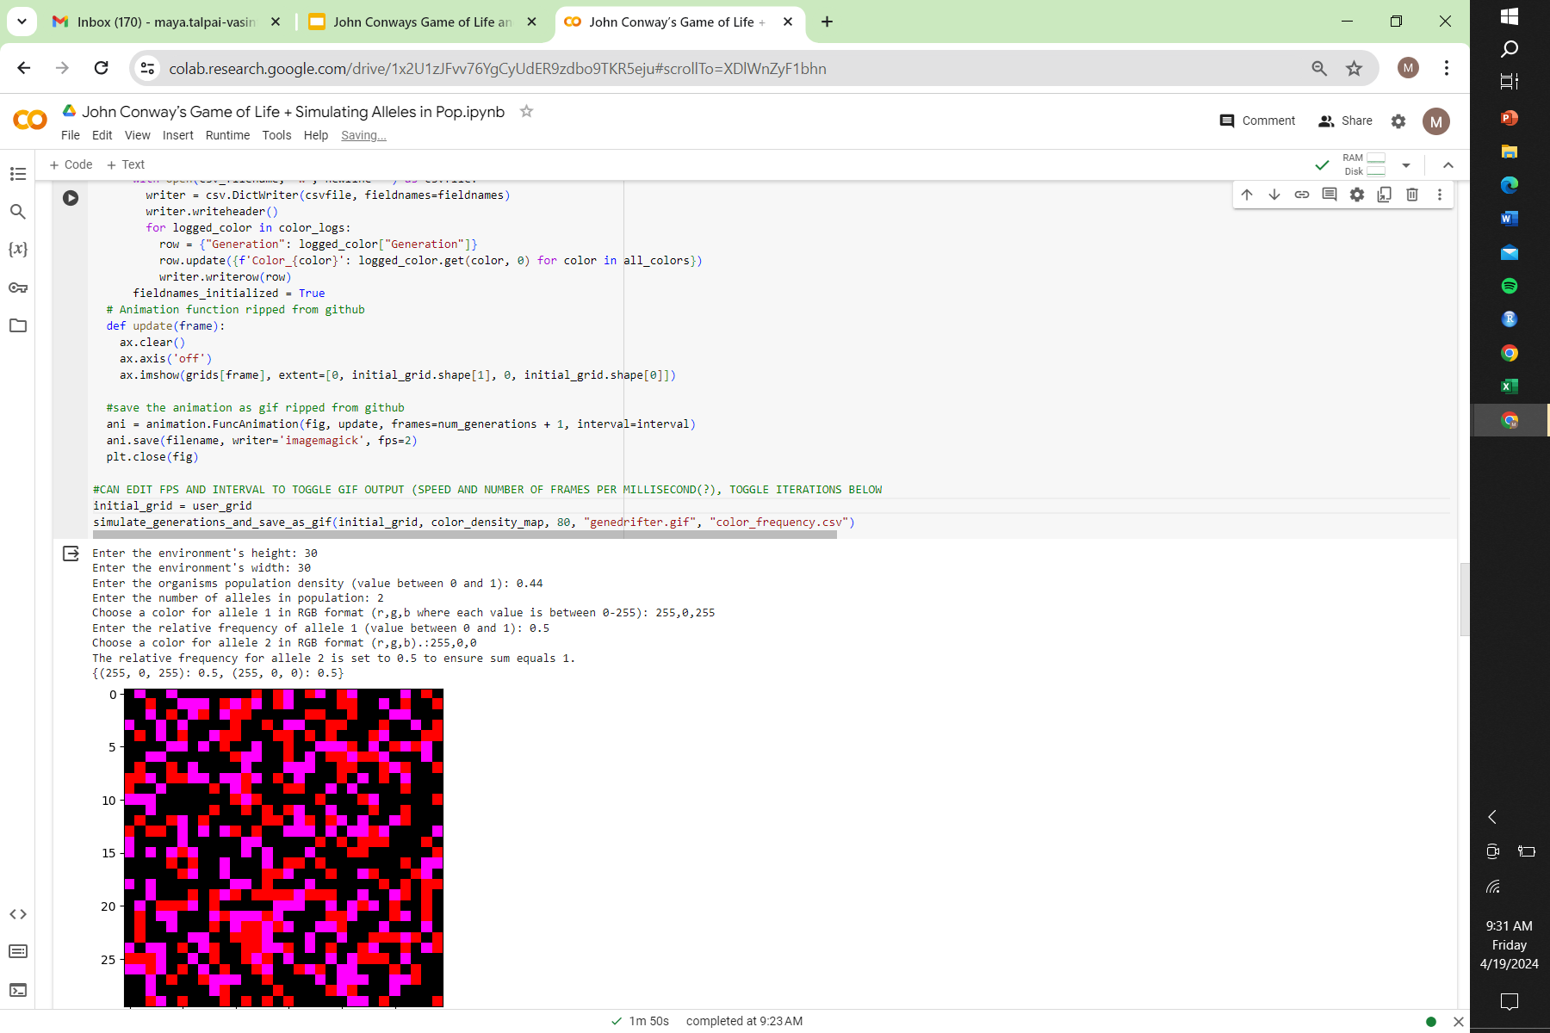
Generational Parameters
Calling the function example:
Notes:
This code uses a map plot to make a grid and logs all of the colors and the frequency of that color over 80 generations -> creating a gif
The for loop calls the generation grid function (which has all of conway’s rules) and also calls color density map on the generation it’s currently on until the end of 80 generations
Then replaces initial grid with new/next generation grid 80 times
Code wouldn’t work with this no gif :( )

Slide 43
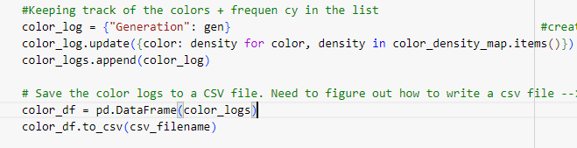
Saving .csv file
Notes:
Saves empty dictionaries in csv file
Calculates all of the different colors as well as frequencies that popped up in 80 generations

Slide 44
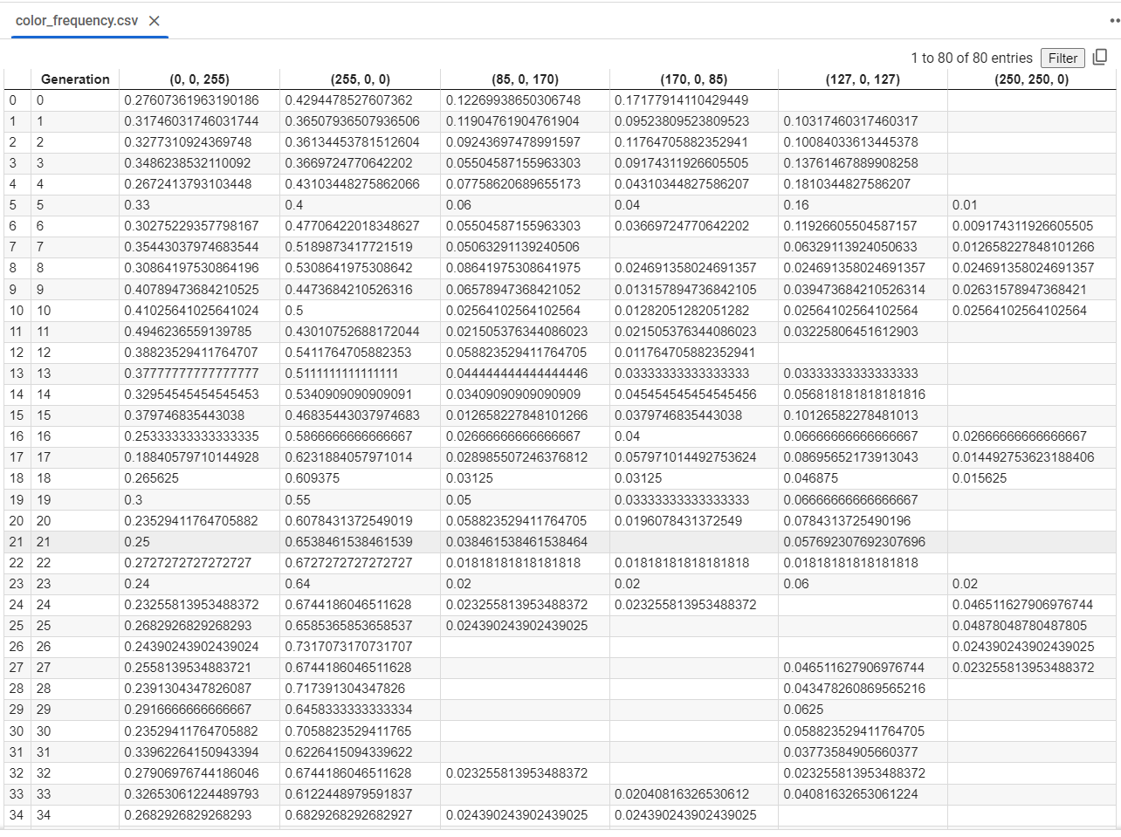
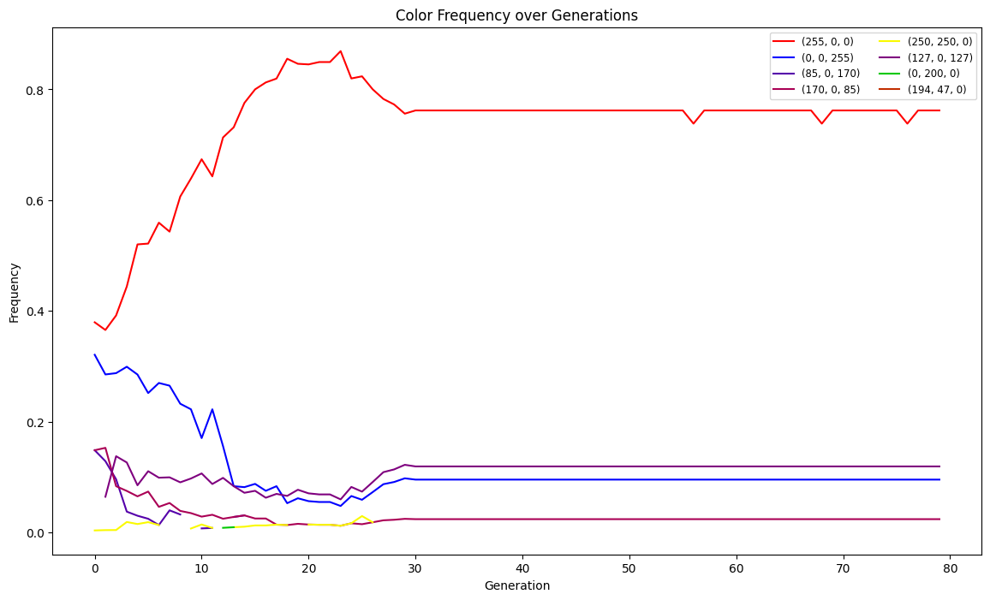
Colors and their relative frequencies across generations are tracked in a .csv file from the {color:map} dictionary. Allows a user to do data analysis later if they want!

Slide 45

GIF
Notes:
We stole code lol

Slide 46
THE END

Slide 47
REFERENCES
Tyshevskyi, P. (2019, April). Reversing Game of Life using genetic algorithms. Medium. Retrieved from https://medium.com/@paveltyshevskyi/reversing-game-of-life-using-genetic-algorithms-45f6209e1daf
Cerruti, U., Dutto, S., & Murru, N. (2020). A symbiosis between cellular automata and genetic algorithms. Chaos, Solitons & Fractals, 134, 109719. https://doi.org/10.1016/j.chaos.2020.109719
Fitness and its role in evolutionary genetics. (2010). PMC. Retrieved from https://www.ncbi.nlm.nih.gov/pmc/articles/PMC2753274/
Zheleznyak, A. (2020). colorful-life: The colorful game of life. GitHub. Retrieved from https://github.com/adam-zheleznyak/colorful-life
Khankasikam, K. (2013). Background research on topic. International Journal of Computer Theory and Engineering. Retrieved from https://www.ijcte.org/papers/769-A009.pdf
Chandrakant, K. (2024). Nature-inspired algorithms. Baeldung. Retrieved from https://www.baeldung.com/cs/nature-inspired-algorithms
The Game of Life. (2020). arXiv. Retrieved from https://arxiv.org/pdf/2007.02894.pdf
Conway’s Game of Life – Python Implementation. (2024). GeeksforGeeks. Retrieved from https://www.geeksforgeeks.org/conways-game-life-python-implementation/

